Slide 1
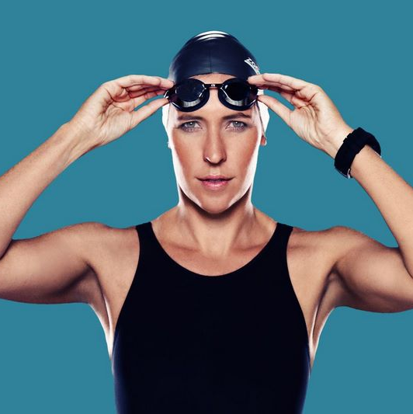
Watch Carina Bruwer: Sizzle Reel
Carina Bruwer is one of Africa’s most decorated female open water marathon swimmers, an internationally renowned musician, a successful entrepreneur and a mother of three.
Known for boldly going where most do not – in the ocean, as well as in business and life – Carina inspires and motivates audiences through her incredible stories of courage, transformation and altruism.
“I KNOW YOU CAN NEGOTIATE WITH FEAR TO ALLOW YOU TO SHOW UP IN THIS WORLD, BECAUSE I HAVE TO DO IT EVERY DAY”
Carina’s extensive ultramarathon swimming resume includes crossing the 36km English Channel, the Gibraltar Straits, False Bay, Nelson Mandela Bay, Walker Bay, Bonifacio Straits, Messina Straits, Triple Country (France – Monaco – Italy), Robben Island and dozens more, with most of her swims being firsts and/or record-breaking feats.
This International Marathon Swimming’s Hall of Fame nominee who was also ranked as one of the World Open Water Swimming Association’s “Top 50 Most Daring, Courageous and Audacious” open water swimmers in the world, founded Swim For Hope in 2014.
Keynote Topics:
AGAINST THE CURRENT
Carina Bruwer
Motivational Speaker –
Extreme Swimmer
*Client is responsible for air travel, transfers and accommodation
** Travels from Cape Town

