Slide 1
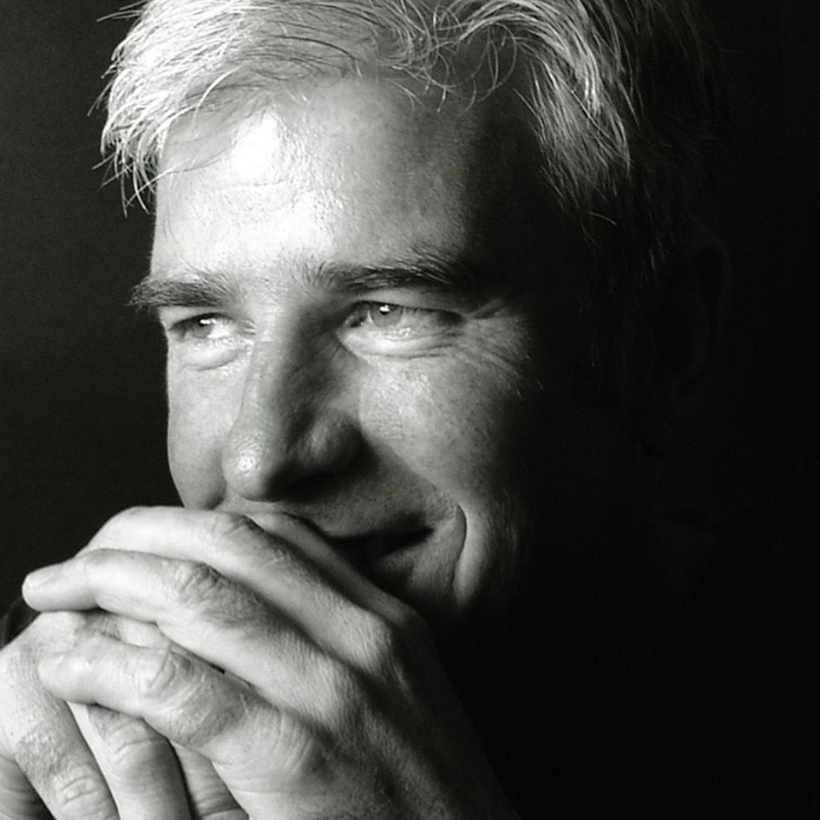
Watch David Grier: Hope TEDX
Watch David Grier: SABC News
David Grier is more than an adventurer — he’s a force of human resilience, creativity, and compassion. A chef by profession and a humanitarian by passion, David has carved an extraordinary life path defined by endurance, empathy, and purpose.
From grueling ultra-distance feats across some of the world’s harshest terrains to nourishing hope through his charitable initiatives, David’s journey inspires individuals and organizations alike to reimagine what’s possible.
David Grier’s journey is a powerful testament to the impact one person can make when purpose meets perseverance.
Through his extreme endurance runs across the globe, David has raised millions for children in need of life-changing cleft surgeries, turning every step into a message of hope.
His keynote inspires audiences to reimagine adversity as a catalyst for growth and to lead with empathy, courage, and resilience.
It’s a moving reminder that true success isn’t just what we achieve — it’s what we give back.
Keynote Topics:
Miles of Purpose: Lessons from a Humanitarian Adventurer
David Grier
Motivational Adventure Speaker –
Humanitarian
*Client is responsible for air travel, transfers and accommodation
** Travels from Cape Town

