Slide 1
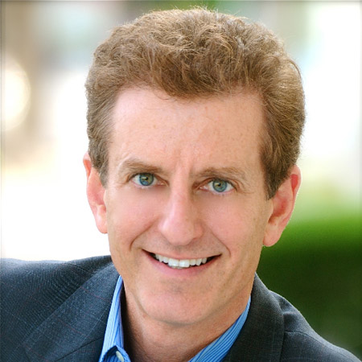



Watch Todd Buchholz: The Price of Prosperity
Former White House director of economic policy and past managing director of the $15 billion Tiger hedge fund
Has crafted economic policy as a public servant and invested in the market and is known for his discussions on critical issues, conveys practical survival tactics and shows audiences how to adapt to the ever-changing global economy
Previously served as President of the G7 Group, Inc., an international consulting firm whose clientele included many of the top security firms, investment banks and money managers across the world including Goldman Sachs and Morgan Stanley
A contributing editor for Worth magazine, and is an 8X author
Inventor of the Math Arrow, a mathematical matrix that makes numbers more intuitive to children, described as “ingenious: by Martin Cooper, the inventor of the cellular phone
Has been featured alongside the most powerful voices in business and economy including Colin Powell, Michael Porter and Jeff Bezos and is a frequent guest on ABC News, PBS, CBS and hosted his own special on CNBC
Keynote Topics:
Prosperity Ahead – or Not?
New Ideas from Dead CEOs
How to Compete in a Global Economy
TODD BUCHHOLZ
Leader on Economic Policy
*Client is responsible for round-trip airfare, ground transportation in event city, hotel accommodations and incidentals for up to two nights

