Slide 1
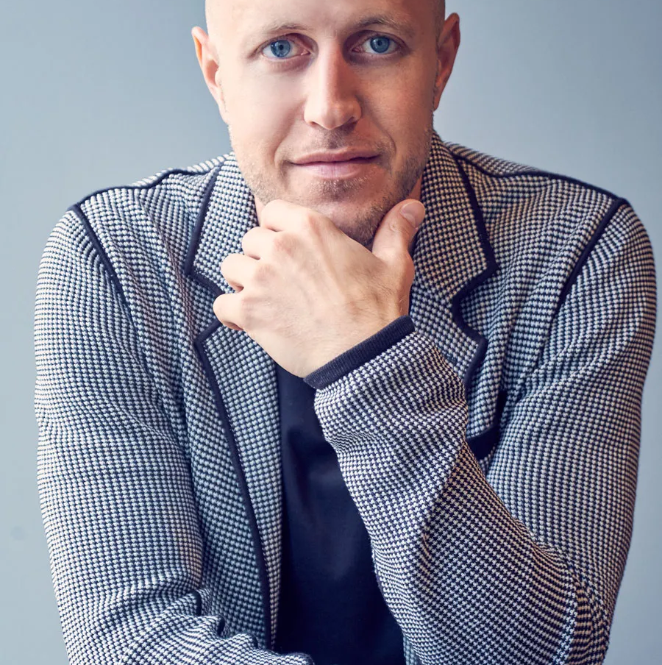

Watch Mike Lee: Speaking Showreel
Mike has shared stories and practical exercises to help people find their own inner power and poise to thrive in business and life.
Mike uses a 5-step process to customize each program to deliver relevant insights and actionable strategies unique to your event theme or meeting goals.
Helping all to use mindset and focus to shift their performance in an ultra-competitive environment with mindfulness.
Key Takeaways:
Mike Lee is the founder of MindShift Labs and possesses a tremendous background spending time on the court with elite NBA stars such as MVP Steph Curry and All-Star Joel Embiid.
Most Popular Keynote Topics
High-Performance Leadership For The FUTURE OF WORK
UNSHAKEABLE: Transformational Leadership Lessons From Basketball’s Elite
BOUNCE BACK: Navigate Uncertainty, Shift Adversity And Lead The Way Forward
MIKE LEE
Purpose Driven Leadership
*Client is responsible for round-trip airfare, ground transportation in event city, hotel accommodations and incidentals for up to two nights

