Slide 1
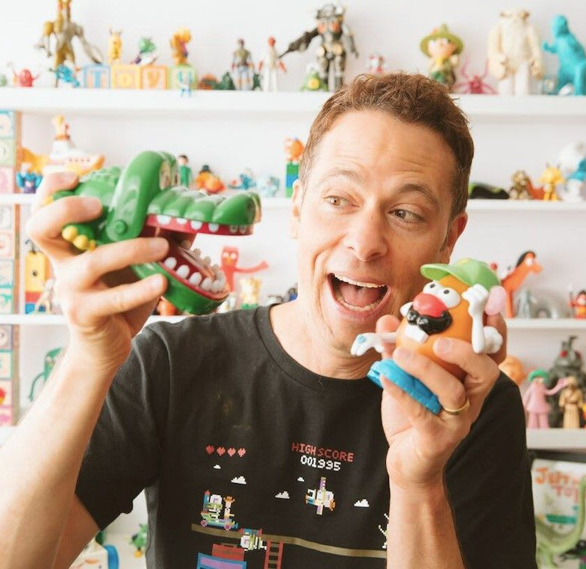
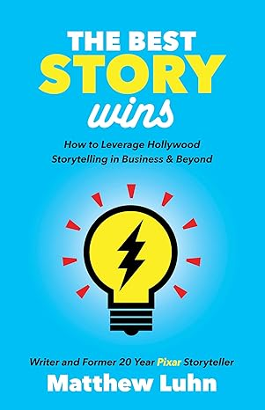
Watch Matthew Luhn: Showreel
Matthew Luhn is a master storyteller, keynote speaker, and former Pixar story artist who has helped shape some of the most beloved animated films of all time.
With over 25 years of experience in the art of storytelling, Luhn has worked on iconic projects like Toy Story, Monsters, Inc., Finding Nemo, and Up.
His expertise extends beyond film, as he now helps businesses, brands, and leaders craft compelling narratives that connect with audiences and drive engagement.
A highly sought-after speaker, Luhn delivers keynote presentations and workshops that unveil the secrets of great storytelling. By blending creativity, emotion, and strategic messaging, he empowers organizations to create authentic and impactful brand stories.
His insights resonate across industries, from entertainment and marketing to leadership and corporate innovation.
Whether inspiring teams to think more creatively or helping brands develop authentic connections with their audiences, Luhn’s storytelling mastery leaves a lasting impression
Keynote Topics:
AI And STORYTELLING
Storytelling for Business
Inspiring Creativity in the Workplace
To Innovation and Beyond
STORYTELLING FOR LEADERS
MATTHEW LUHN
Expert in Creativity
*Client is responsible for first class, round-trip airfare, ground transportation in event city, hotel accommodations and incidentals for up to two nights
** Travels from San Francisco, CA

