Slide 1
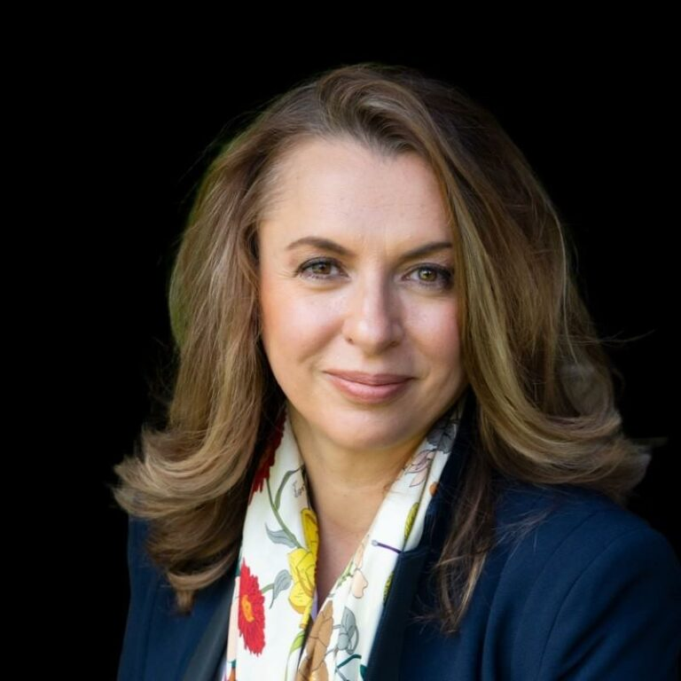
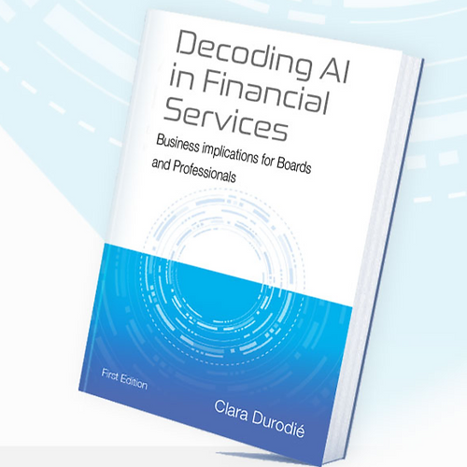
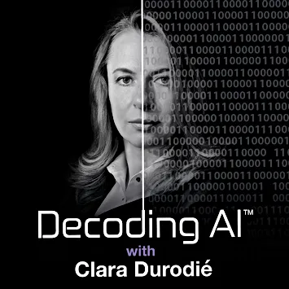
Watch Clara Durodie: AI in plain English
Watch Clara Durodie: 2 Bulls & a Bear
Listen to Podcast Show: Decoding AI
Clara Durodié is a top AI keynote speaker and technology strategist specializing in applied artificial intelligence (AI) in financial services, with a focus on AI & Ethics and the strategic adoption of AI for business profitability.
She is internationally recognized for her expertise, advising Boards of leading financial institutions, think-tanks, governments, and academia.
Clara is a frequent presenter at leading conferences around the globe, including SIBOS, Money 2020, Innovate Finance Global Summit, AI World and at London Business School where she addressed an audience from leading universities around the world such as Harvard, Stanford, MIT and Cambridge.
Clara was also invited to teach at the Oxford Artificial Intelligence course, organised by the University of Oxford.
Keynote Topics:
Cybersecurity and AI : fighting fire with fire
Artificial intelligence in plain English
Trust with Algorithms – what is it and how to build it
Trust by design – how to start right
Boards and AI strategy: modern governance
Clara Durodie
Decoding Expert Speaker
*Client is responsible for round-trip airfare, ground transportation, hotel accommodations and incidentals
** Clara travels from London, UK

