Slide 1

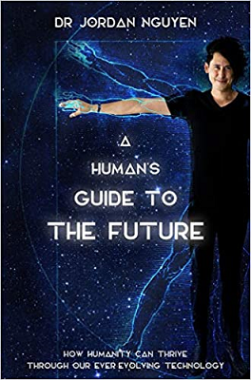
Technology is Reinventing Humanity | TedX
Dr Jordan Nguyen is a leading Australian engineer, inventor and innovator, who is committed to improving as many lives as possible, as well as becoming a driving force behind both human and technological evolution as we move into the future.
An internationally renowned engineer for humanity, Jordan designs life-changing technologies to transform the lives of people with disabilities and the elderly through his role as founder of Psykinetic, a social business committed to bringing positive, sustainable and life-altering change.
Author of A HUMAN'S GUIDE TO THE FUTURE (with Pan Macmillan), Jordan is also an award-winning documentary maker and presenter. In 2016 he collaborated with the Australian based production company, The Feds, and the ABC Catalyst to create and present his first TV documentary Becoming Superhuman, which went on to win many prestigious awards both locally and internationally.
Take Aways:
Awe-inspiring, thought-provoking, big-picture talks to entertain, educate, and stretch the minds of audiences
Motivational / Inspiration talks to empower and activate audiences to tackle new challenges and collaborations
Creativity and new ways of thinking from a story-led, humanity-focussed technology creation perspective
Sci-fi technologies changing the world and how these will affect our businesses
STEM/STEAM and the important characteristics and traits for future careers
Next generations coming through and why businesses must prepare for a changing workforce
Keynote Categories:
Beyond Superhuman: Technology for Humanity
AI, Evolving Technology & the Human Experience
Digital Transformation & Future Transformations
Dr. Jordan Nguyen
Biomedical Engineer & Technology Futurist
*Client is responsible for round-trip airfare, ground transportation in event city, hotel accommodations and incidentals for up to two nights

