Slide 1
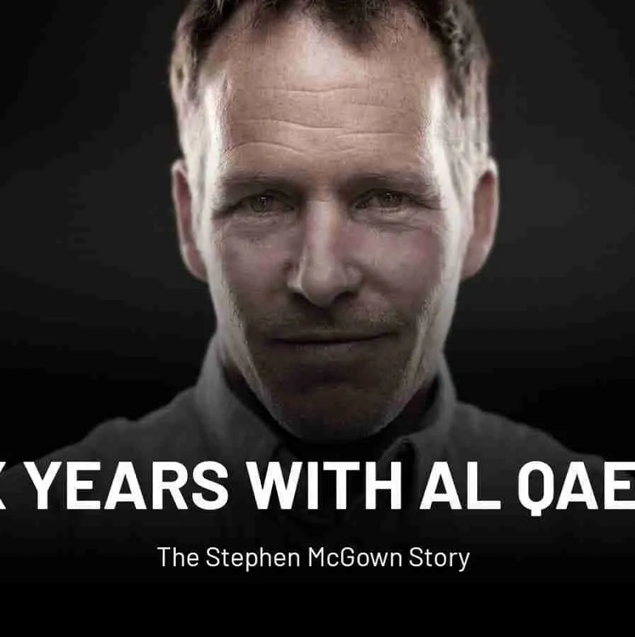
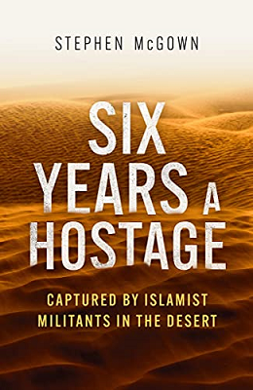
Watch Stephen McGown: 6 years captive by Al Qaeda
Watch Stephen McGown: Part 2 of the video
During Stephen McGown abduction, he was kept far from civilisation, deep in the Sahara, away from the searching eyes of French surveillance planes and drones. He was allowed limited communication with his family in the first six months of his captivity.
Living outdoors in harsh conditions meant that he had to acquire a variety of new skills including how to protect himself from the elements as well as how to communicate across language and cultural boundaries.
But most of all he learnt how to stay alive; remain positive and be present when everything was stacked against him.
Stephen’s talk is a story about resilience and overcoming adversity amidst harsh weather conditions, a different culture, language and religion.
Key Takeaways:
An unexpected turn of events crushed his lifelong dream. En route home, Stephen was abducted by Al Qaeda and held hostage in Mali for almost 6 years.
Most Popular Keynote Topics
Inspiration
STEPHEN MCGOWN
Inspirational Motivation Speaker
*Client is responsible for round-trip airfare, ground transportation in event city, hotel accommodations and incidentals for up to two nights

